Slide 1

LIVING IN THE PRESENT

Slide 2

Introduction
The present makes us exist in a certain place. Although we sometimes underestimate the present, everything we do in the present moment will be our personal inheritance. Living in the present allows you to build a whole world that will then become your legacy.
Living in the present implies being aware of each situation and finding our eternity in every single moment. Naive people spend their time looking at other places while standing on an island full of life opportunities. There are no other places, though… There’s no other life but this one.

Slide 3

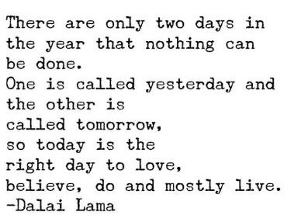

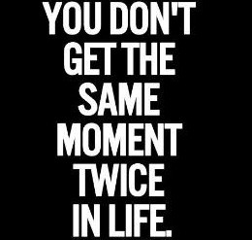
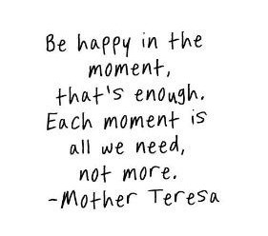
BE HERE NOW

Slide 4
The present makes us exist in a certain place.
Although we sometimes underestimate the present, everything we do in the present
moment will be our personal inheritance. Living in the present allows you to build a whole world that will then become your legacy.
Living in the present implies being aware of each situation and finding our eternity in every single moment. Naive people spend their time looking at other places while standing on an island full of life opportunities. There are no other places, though… There’s no other life but this one.
Importance of living the life in present

Slide 5
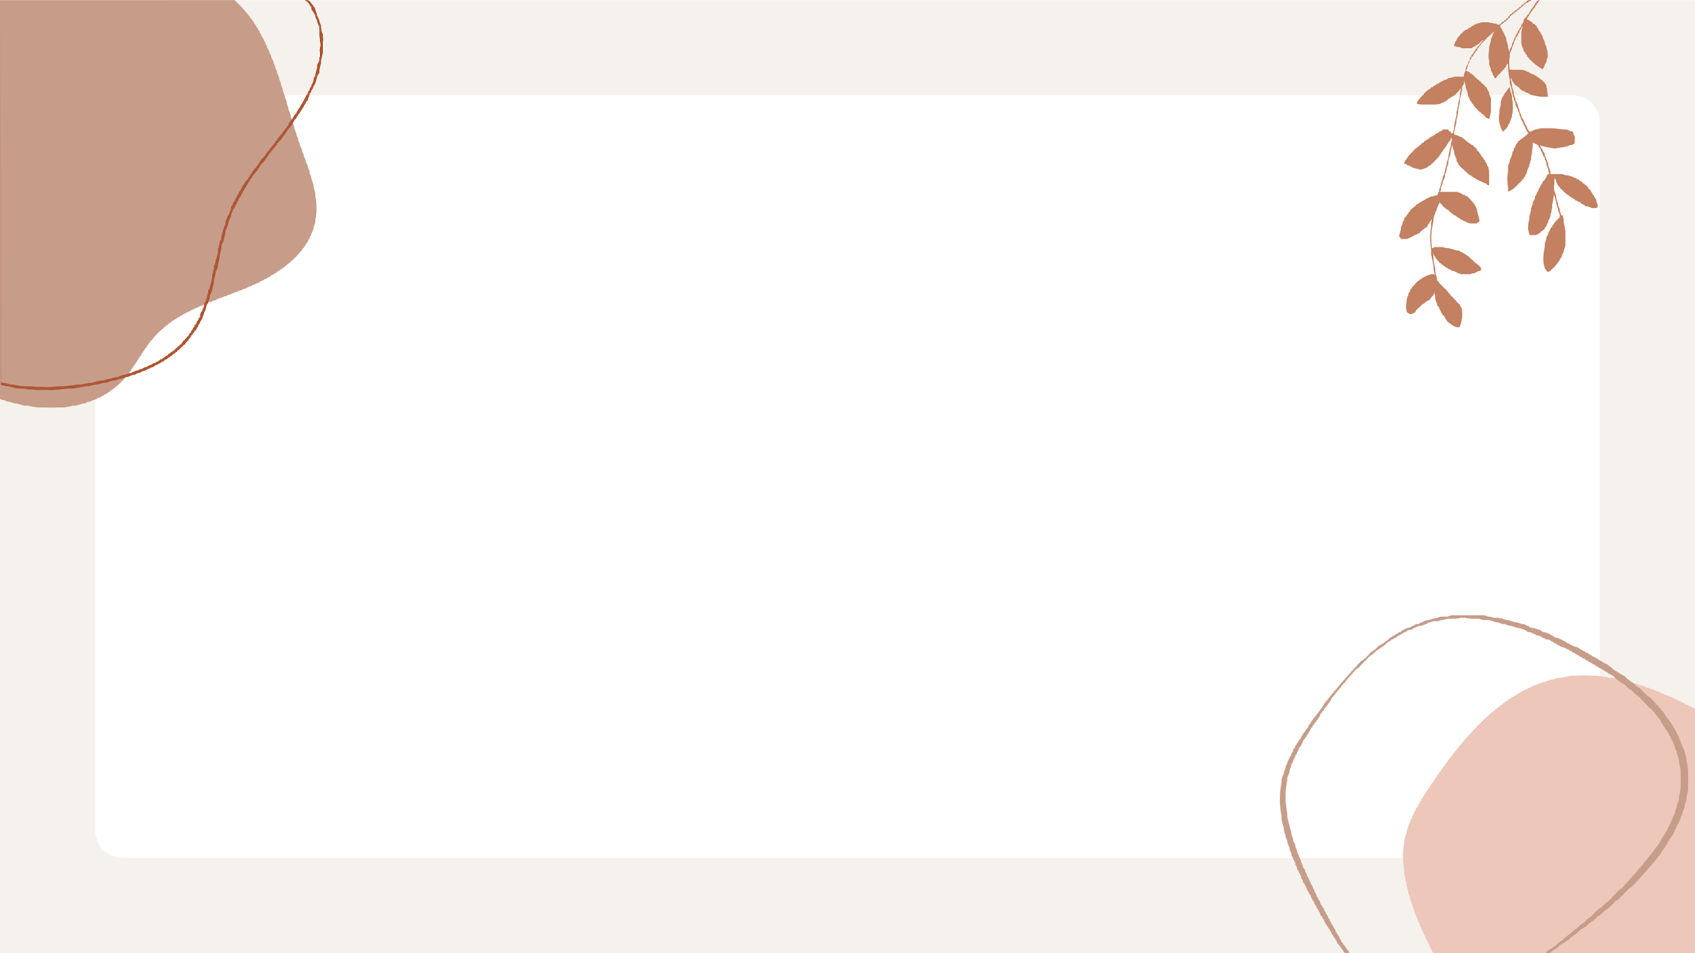
HOW TO LIVE LIFE IN PRESENT

Slide 6
Focus on One Thing at a Time
If you're working on something, give it all of your attention. When you find yourself thinking about other things or checking your phone because you don't feel like doing the task at hand, stop and turn that focus back to what's in front of you. Research shows that when you are fully focused on what's happening at that moment, you can better remember details in the long term anyway.

Slide 7
Be Grateful For What You Have Now
Part of living in the present moment is taking the time to be grateful for what you have now (not in the past or in the future). If you are constantly focused on things you don't have, you aren't taking the time to appreciate what you have right now at this moment.

Slide 8
Accept Things As They Are
If you want to start living in the present moment, you need to let go of how you think things should be and accept them for what they are. You cannot control everything that happens around you; sometimes life is going to be different than how you want it to be. Practicing acceptance will help you let go of the things in your life that are out of your control.

Slide 9
In conclusion, living in the present moment requires that you take the time to appreciate where you are, what you're doing, and who is with you. Instead of becoming caught up in the past or worrying about what will happen in the future, try to savor each moment as it passes.
CONCLUSION

Slide 10

Thank You!

